Slide 1
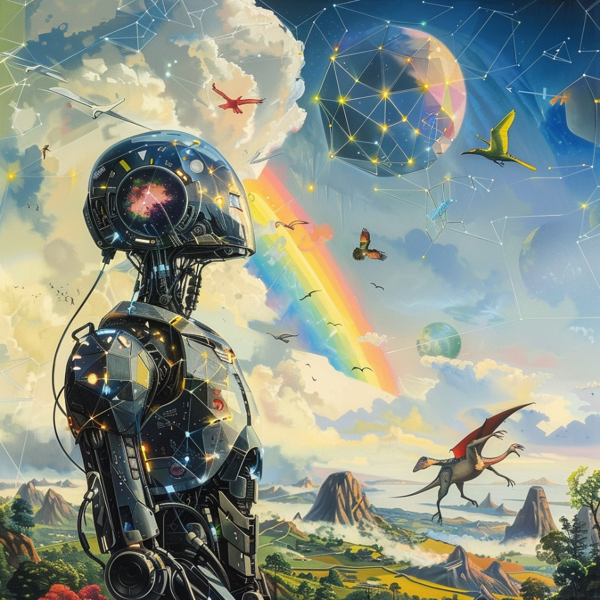


Scholarly Document Processing at ACL 2025, 31.07.2025
Towards an Artificial Muse for new ideas in Science
Mario Krenn
Artificial Scientist Lab
. @mariokrenn6240
http://mariokrenn.wordpress.com/

Slide 2
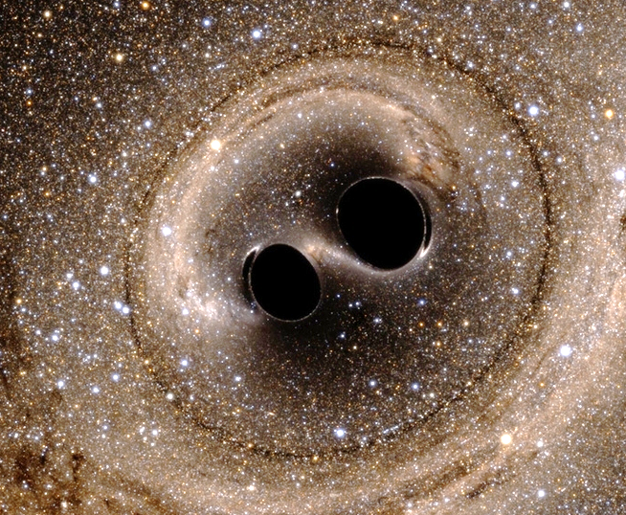
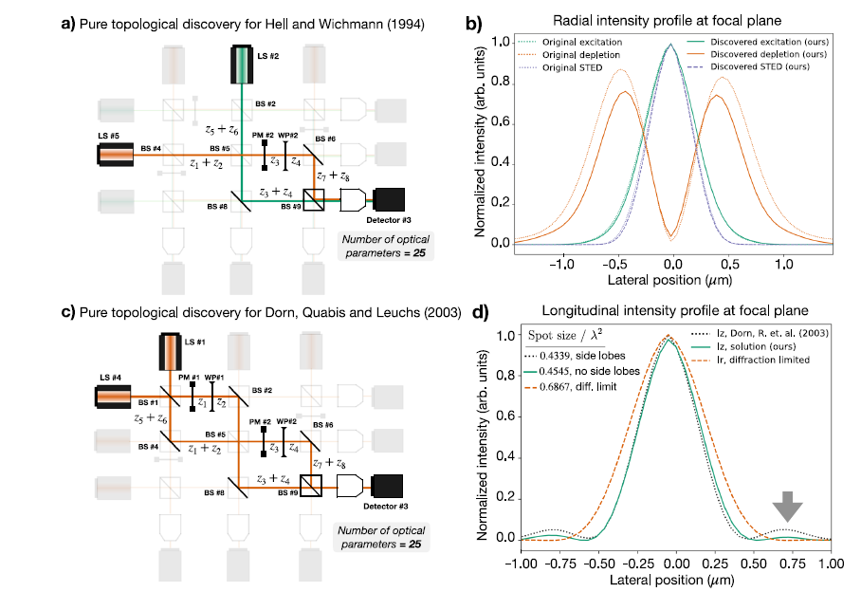
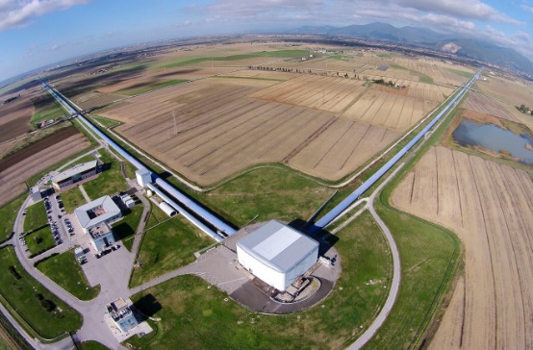
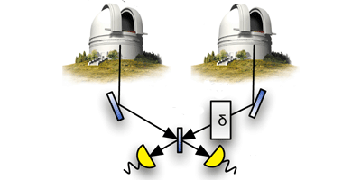
Mario Krenn
De-novo Design of Physics Experiments with AI
Gravitational wave Detections
Phys. Rev. X 15, 021012 (2025)
Super-Resolution Microscopy
Nature Comm. 15, 10658 (2024)
Quantum-Enhanced Telescopes
arXiv 2508:nnnnn (hopefully)

Slide 4
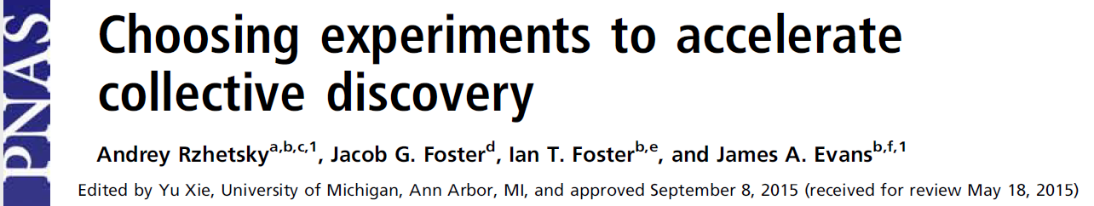
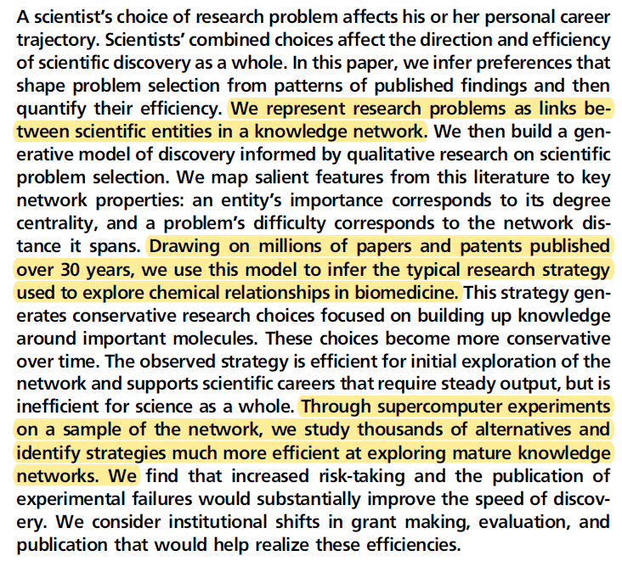
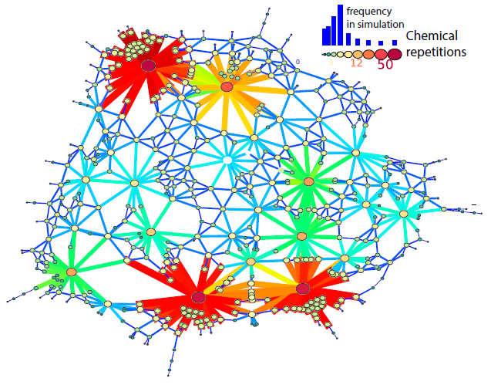
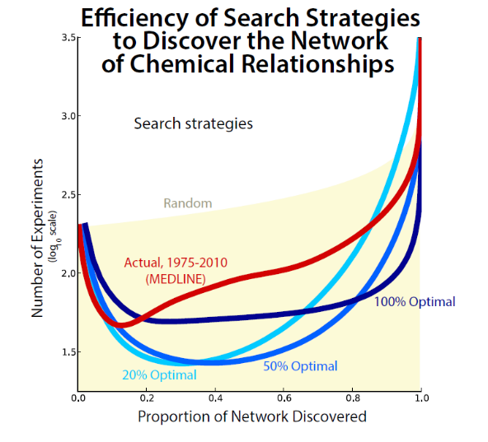

Slide 5
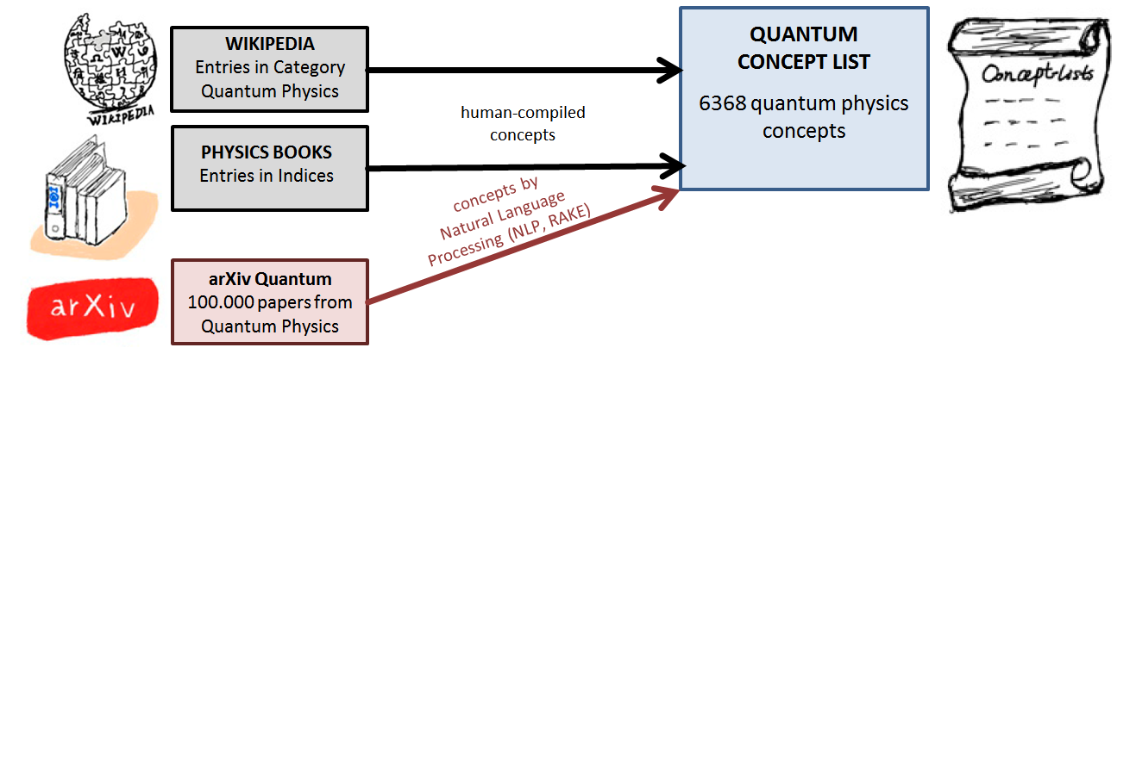
Mario Krenn
Mario Krenn
MK, Zeilinger "Predicting Research Trends with Semantic and
Neural Networks with an application in Quantum Physics", PNAS 117(4), 1910 (2020).

Slide 6
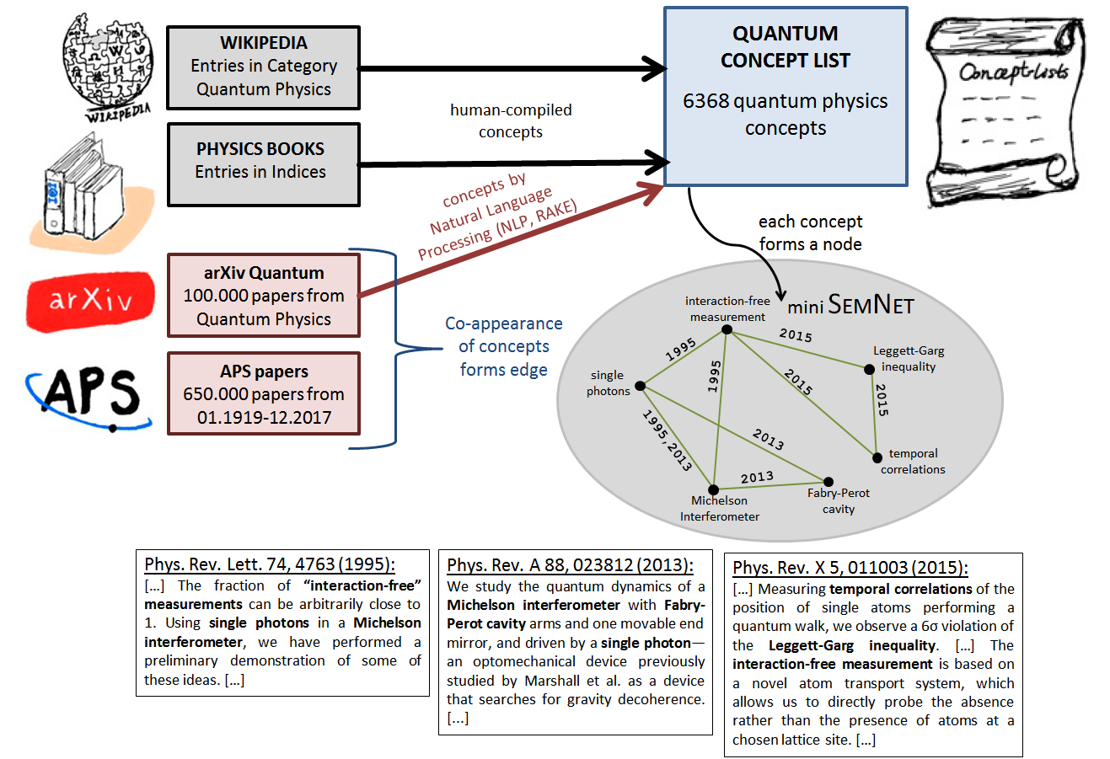
Mario Krenn
Mario Krenn
MK, Zeilinger "Predicting Research Trends with Semantic and
Neural Networks with an application in Quantum Physics", PNAS 117(4), 1910 (2020).

Slide 7
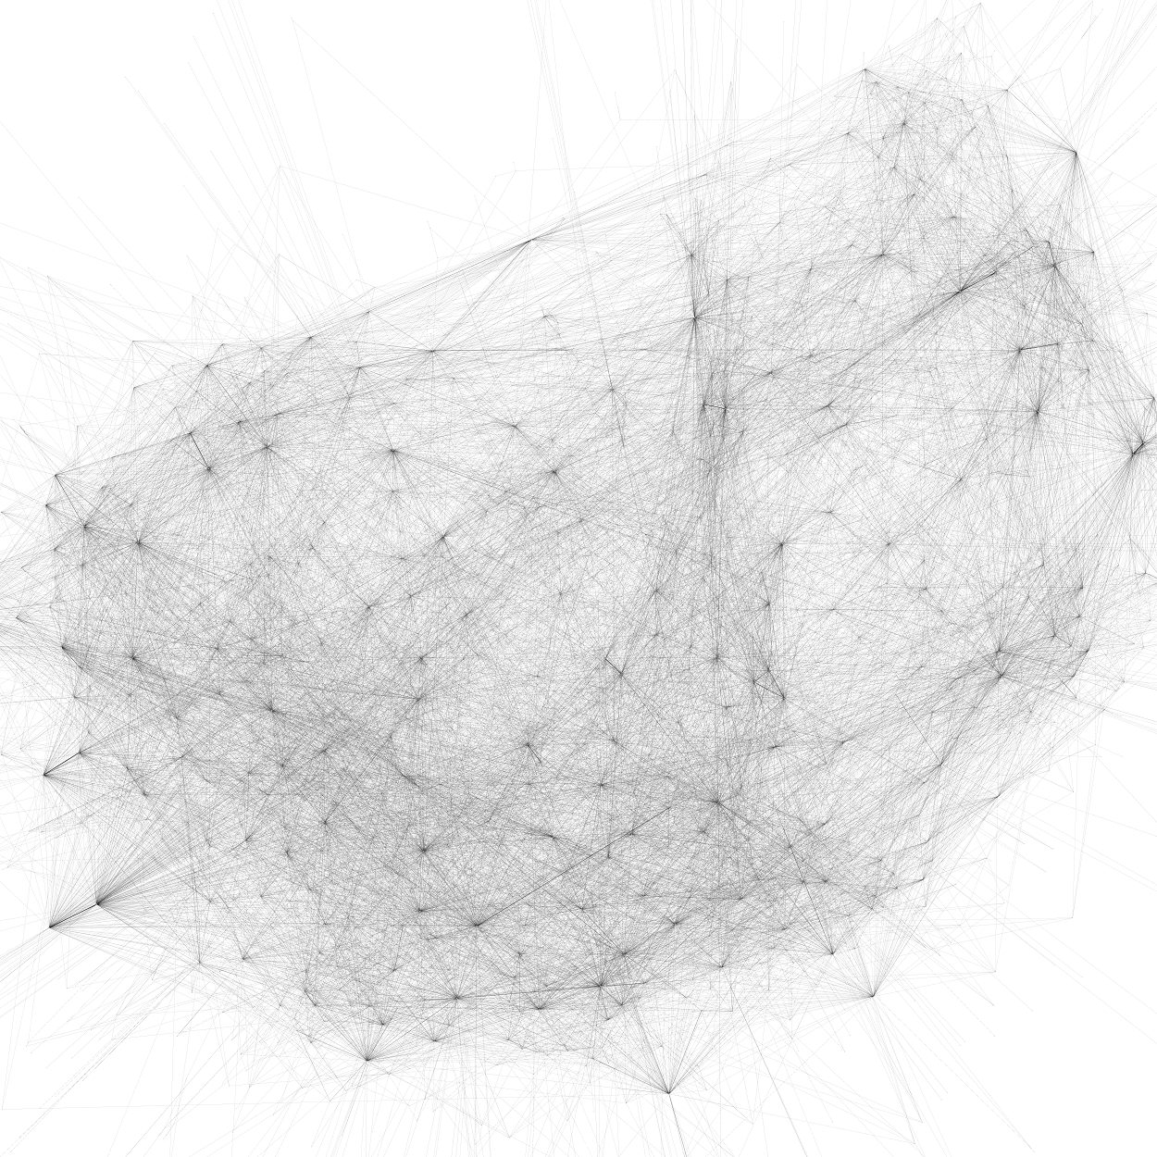

Slide 8
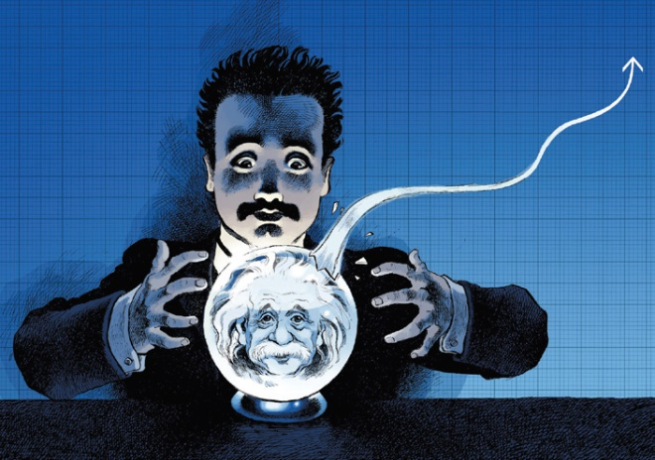
Mario Krenn
Mario Krenn
What will human researchers work on
in the future?
MK, Zeilinger "Predicting Research Trends with Semantic and
Neural Networks with an application in Quantum Physics", PNAS 117(4), 1910 (2020).

Slide 9
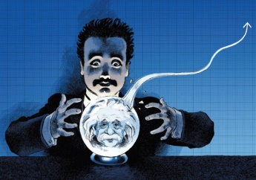
Mario Krenn
Mario Krenn
What will human researchers work on
in the future?
Which unconnected pairs of concepts will be investigated together in 5 years?
MK, Zeilinger "Predicting Research Trends with Semantic and
Neural Networks with an application in Quantum Physics", PNAS 117(4), 1910 (2020).

Slide 10
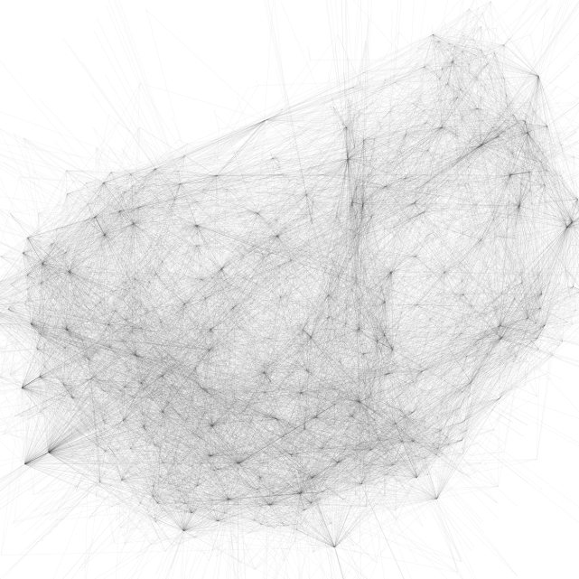
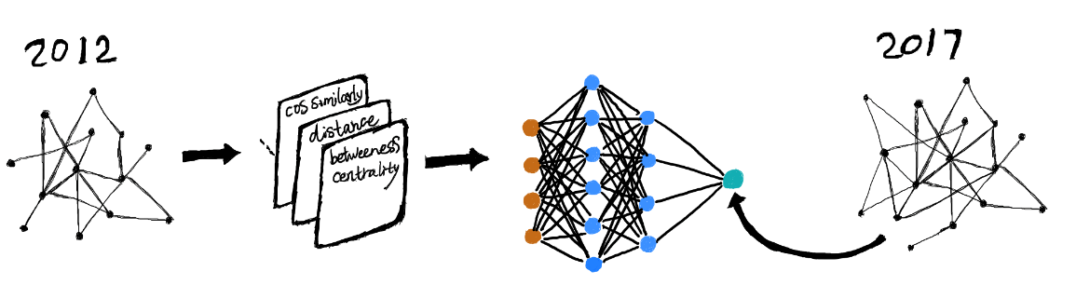
Mario Krenn
Mario Krenn
What will human researchers work on
in the future?
Which unconnected pairs of concepts will be investigated together in 5 years?
Link Prediction
via Neural Networks
2015
2020
MK, Zeilinger "Predicting Research Trends with Semantic and
Neural Networks with an application in Quantum Physics", PNAS 117(4), 1910 (2020).

Slide 11
Mario Krenn
Mario Krenn
What will human researchers work on
in the future?
Which unconnected pairs of concepts will be investigated together in 5 years?
Link Prediction
via Neural Networks
2015
2020
Evaluate with 2025: AUC=85%
MK, Zeilinger "Predicting Research Trends with Semantic and
Neural Networks with an application in Quantum Physics", PNAS 117(4), 1910 (2020).

Slide 12
Mario Krenn
Mario Krenn
What will human researchers work on
in the future?
Which unconnected pairs of concepts will be investigated together in 5 years?
Link Prediction
via Neural Networks
2020
2025
Then: From 2025 to 2030!
MK, Zeilinger "Predicting Research Trends with Semantic and
Neural Networks with an application in Quantum Physics", PNAS 117(4), 1910 (2020).

Slide 13
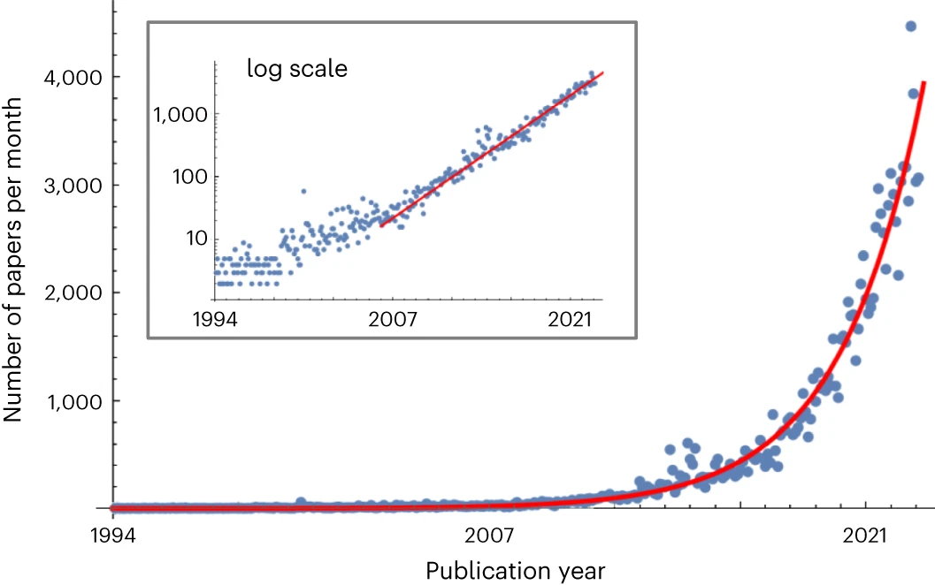
Mario Krenn
Mario Krenn
What will human researchers work on
in the future: But much better…
MK, et al., Forecasting the future of artificial intelligence with machine learning-based link prediction in an
exponentially growing knowledge network, Nature Machine Intelligence 5, 1326 (2023).

Slide 14
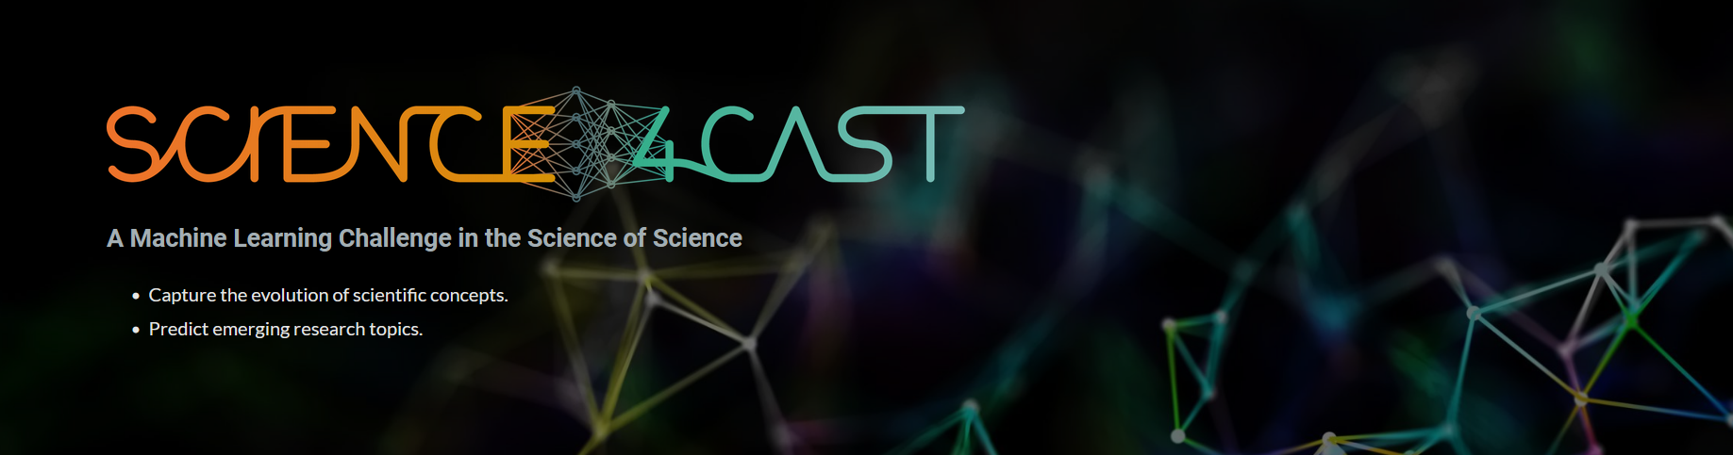
Mario Krenn
Mario Krenn
What will human researchers work on
in the future: But much better…
MK, et al., Forecasting the future of artificial intelligence with machine learning-based link prediction in an
exponentially growing knowledge network, Nature Machine Intelligence 5, 1326 (2023).

Slide 15
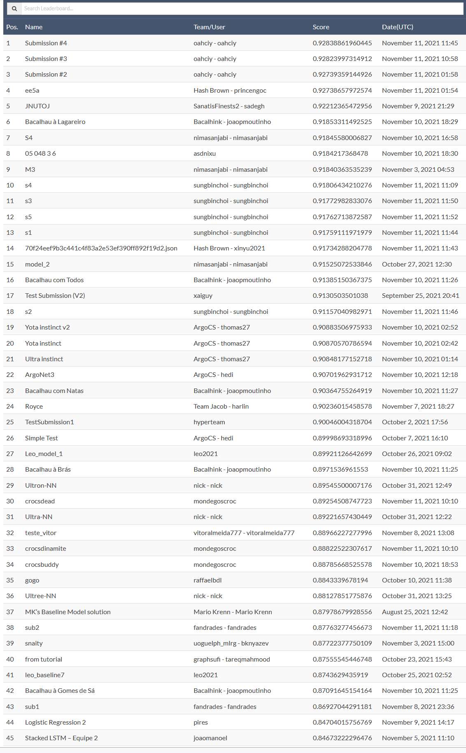
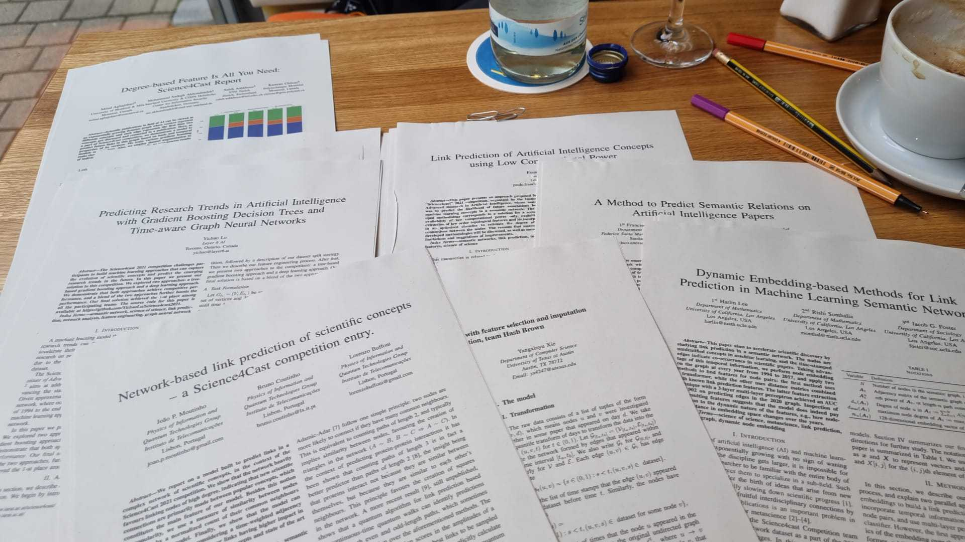
Mario Krenn
Mario Krenn
What will human researchers work on
in the future: But much better…
72 Submissions!
Graph-Neural Networks
Transformers
Pure Network Theory
Automated feature engineering
MK, et al., Forecasting the future of artificial intelligence with machine learning-based link prediction in an
exponentially growing knowledge network, Nature Machine Intelligence 5, 1326 (2023).

Slide 16
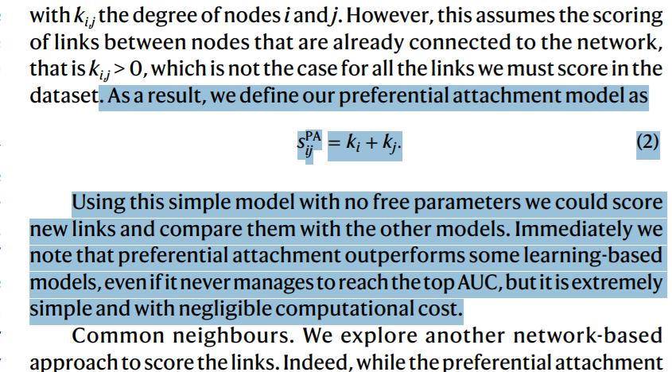
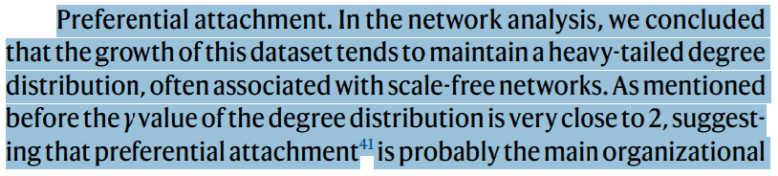
Mario Krenn
Mario Krenn
What will human researchers work on
in the future: But much better…
Pure Network Theory
MK, et al., Forecasting the future of artificial intelligence with machine learning-based link prediction in an
exponentially growing knowledge network, Nature Machine Intelligence 5, 1326 (2023).

Slide 17
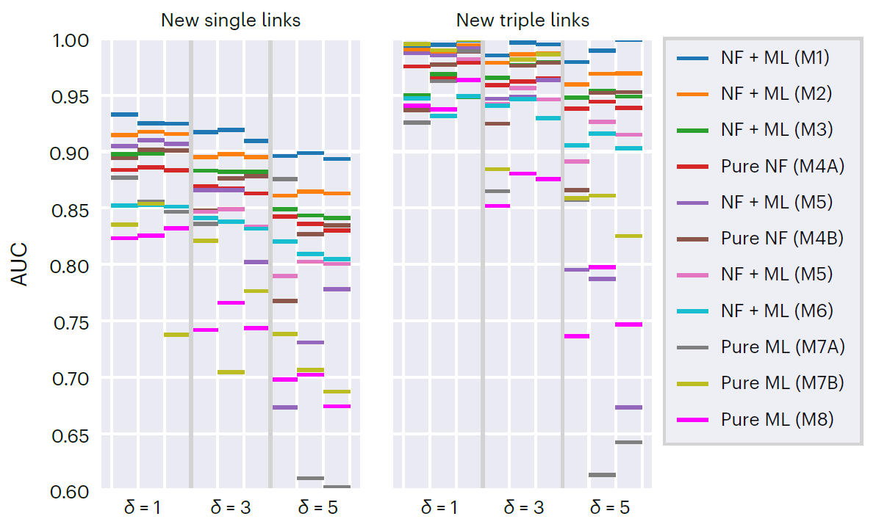
Mario Krenn
Mario Krenn
What will human researchers work on
in the future: But much better…
MK, et al., Forecasting the future of artificial intelligence with machine learning-based link prediction in an
exponentially growing knowledge network, Nature Machine Intelligence 5, 1326 (2023).

Slide 18
Mario Krenn
Mario Krenn
What will human researchers work on
in the future: But much better…
MK, et al., Forecasting the future of artificial intelligence with machine learning-based link prediction in an
exponentially growing knowledge network, Nature Machine Intelligence 5, 1326 (2023).

Slide 19
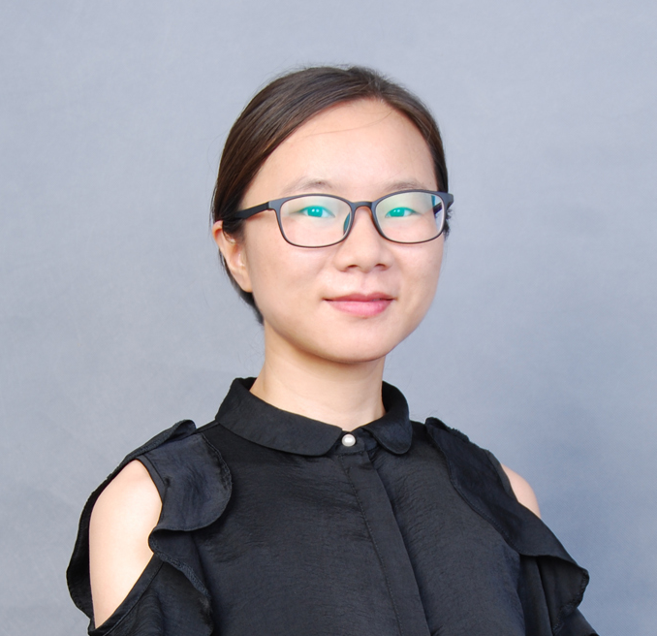
Mario Krenn
Mario Krenn
What will be impactful?
Dr. Xuemei Gu
(now: Gu group, Uni Jena)

Slide 20
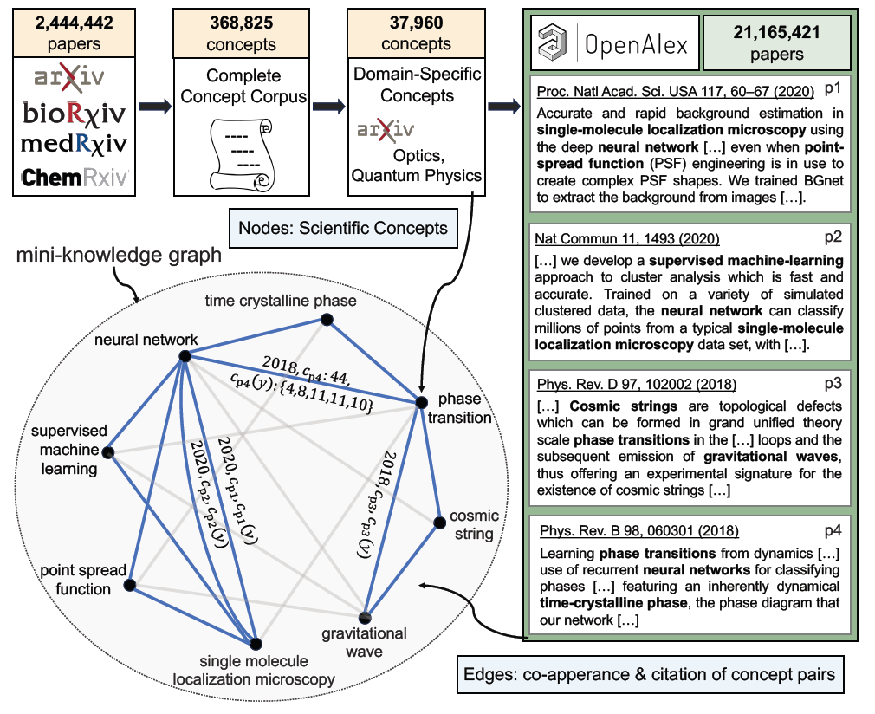
Mario Krenn
Mario Krenn
What will be impactful?
Gu, Krenn, Forecasting high-impact research topics via machine learning on
evolving knowledge graphs, Machine Learning: Science & Technology, 6, 025041 (2025)

Slide 21
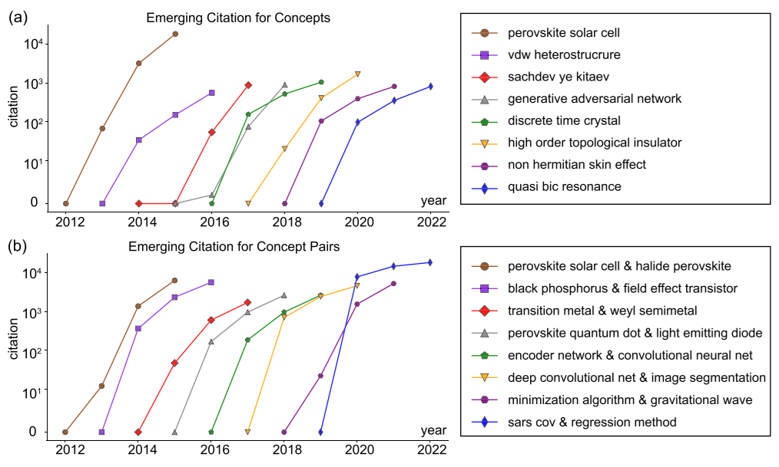
Mario Krenn
Mario Krenn
What will be impactful?
Gu, Krenn, Forecasting high-impact research topics via machine learning on
evolving knowledge graphs, Machine Learning: Science & Technology, 6, 025041 (2025)

Slide 22
Mario Krenn
Mario Krenn
What will be impactful?
Gu, Krenn, Forecasting high-impact research topics via machine learning on
evolving knowledge graphs, Machine Learning: Science & Technology, 6, 025041 (2025)

Slide 23
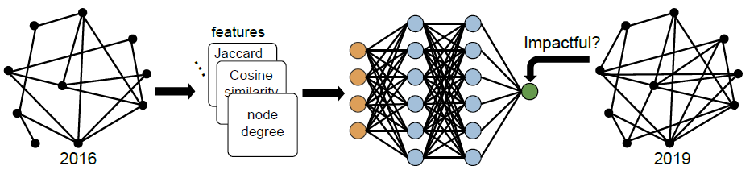
Mario Krenn
Mario Krenn
What will be impactful?
Gu, Krenn, Forecasting high-impact research topics via machine learning on
evolving knowledge graphs, Machine Learning: Science & Technology, 6, 025041 (2025)

Slide 24
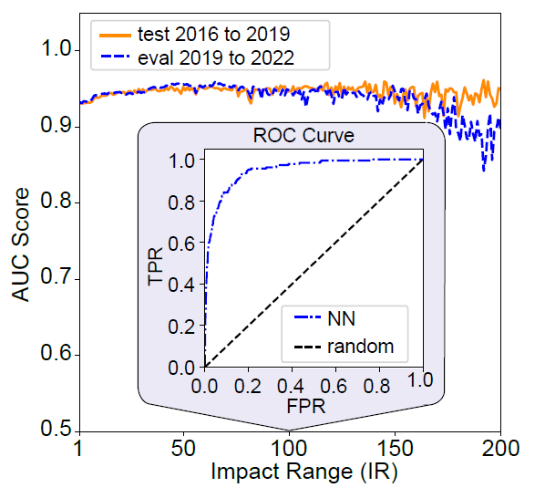
Mario Krenn
Mario Krenn
What will be impactful?
Gu, Krenn, Forecasting high-impact research topics via machine learning on
evolving knowledge graphs, Machine Learning: Science & Technology, 6, 025041 (2025)

Slide 25
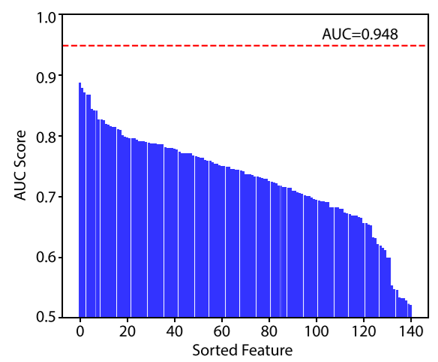
Mario Krenn
Mario Krenn
What will be impactful?
Feature importance:
Which property predicts impact best?
Gu, Krenn, Forecasting high-impact research topics via machine learning on
evolving knowledge graphs, Machine Learning: Science & Technology, 6, 025041 (2025)

Slide 26
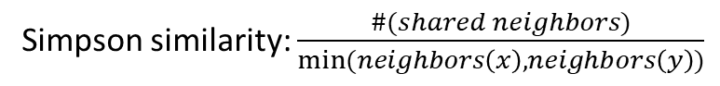
Mario Krenn
Mario Krenn
What will be impactful?
Feature importance:
Which property predicts impact best?
Simpson similarity: $\frac{\#(shared neighbors)}{min⁡(neighbors\left(x\right),neighbors\left(y\right))}$
Gu, Krenn, Forecasting high-impact research topics via machine learning on
evolving knowledge graphs, Machine Learning: Science & Technology, 6, 025041 (2025)

Slide 27
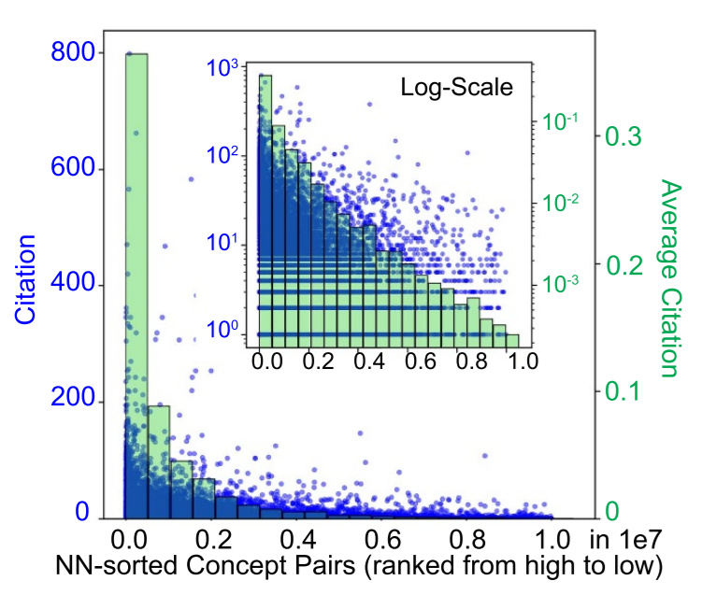
Mario Krenn
Mario Krenn
What will be impactful?
Gu, Krenn, Forecasting high-impact research topics via machine learning on
evolving knowledge graphs, Machine Learning: Science & Technology, 6, 025041 (2025)

Slide 28
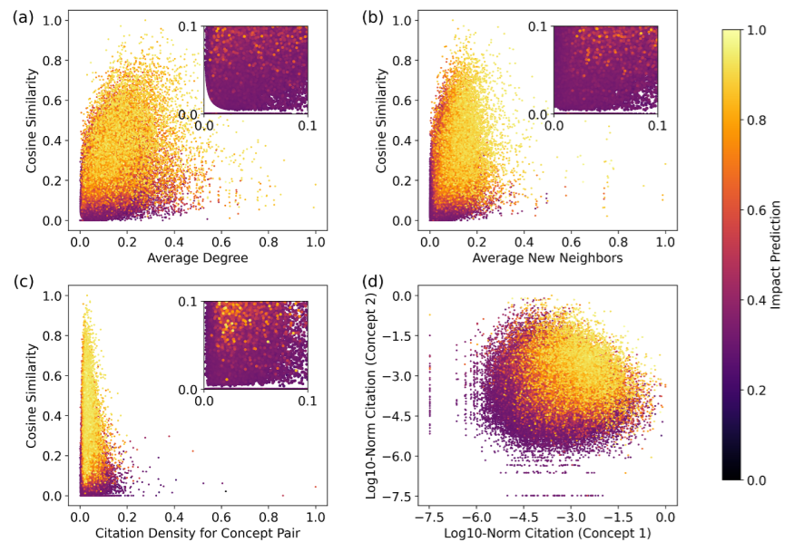
Mario Krenn
Mario Krenn
What will be impactful?
Gu, Krenn, Forecasting high-impact research topics via machine learning on
evolving knowledge graphs, Machine Learning: Science & Technology, 6, 025041 (2025)

Slide 29
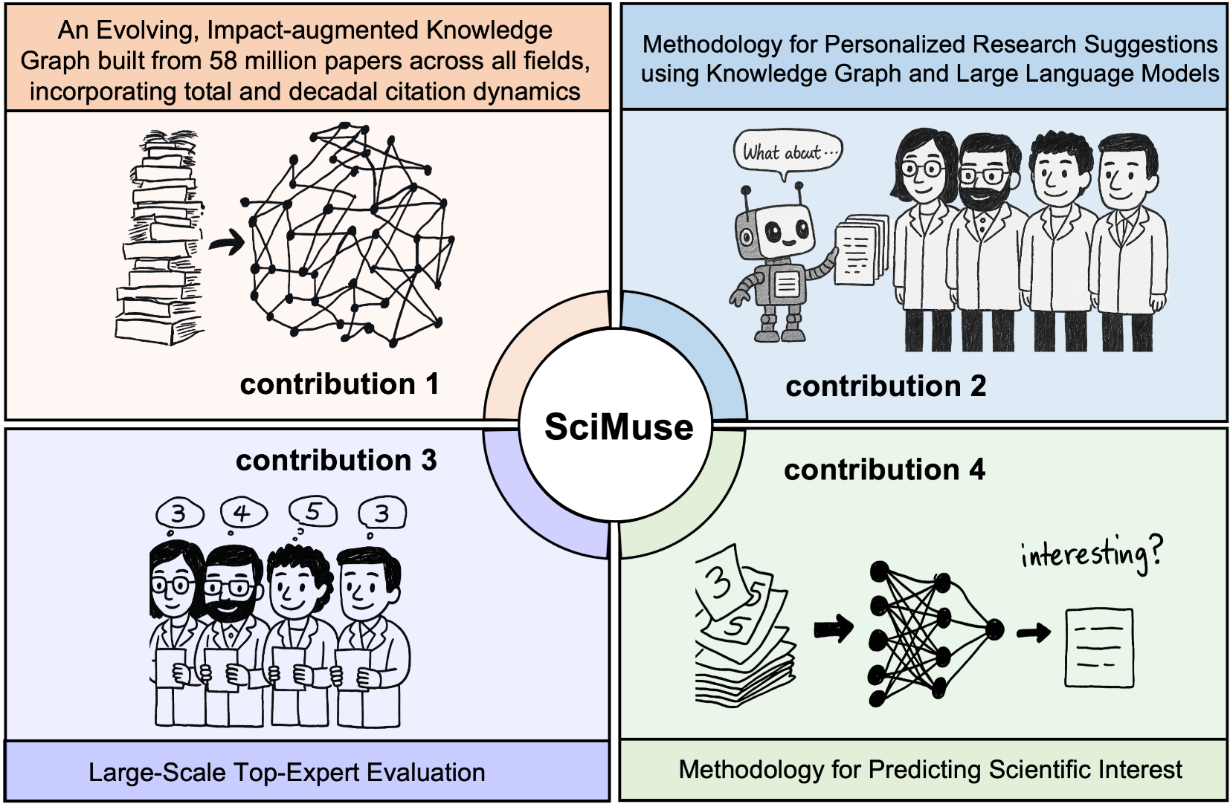
Mario Krenn
Mario Krenn
Real project ideas?
Gu, Krenn, Interesting Scientific Idea Generation using Knowledge Graphs and LLMs:
Evaluations with 100 Research Group Leaders, arXiv:2405.17044.

Slide 30
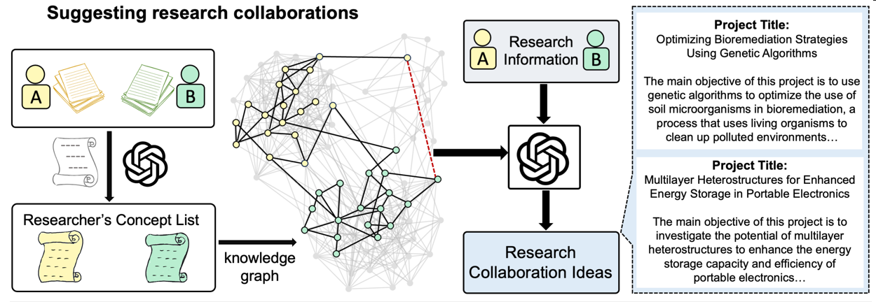
Mario Krenn
Mario Krenn
Real project ideas?
Gu, Krenn, Interesting Scientific Idea Generation using Knowledge Graphs and LLMs:
Evaluations with 100 Research Group Leaders, arXiv:2405.17044.

Slide 31
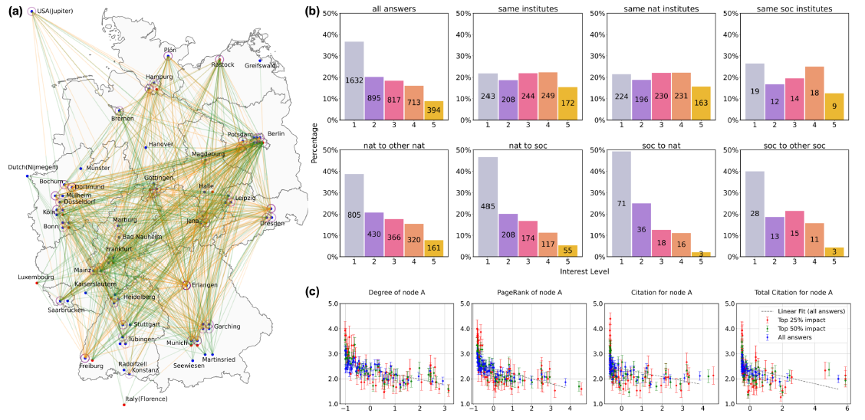
Mario Krenn
Mario Krenn
Real project ideas?
Gu, Krenn, Interesting Scientific Idea Generation using Knowledge Graphs and LLMs:
Evaluations with 100 Research Group Leaders, arXiv:2405.17044.

Slide 32
Mario Krenn
Mario Krenn
Real project ideas?
Gu, Krenn, Interesting Scientific Idea Generation using Knowledge Graphs and LLMs:
Evaluations with 100 Research Group Leaders, arXiv:2405.17044.

Slide 33
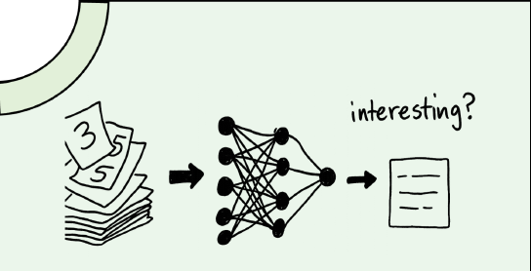
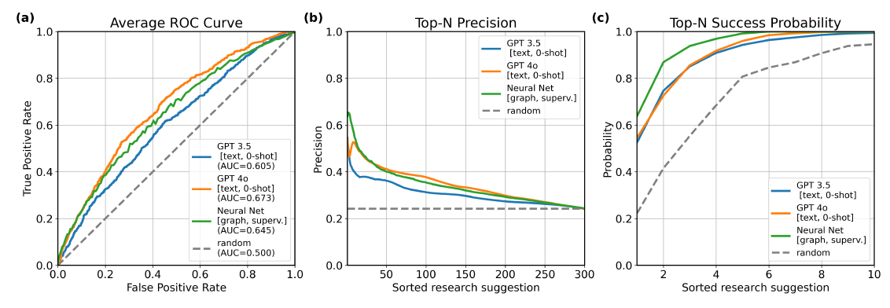
Mario Krenn
Mario Krenn
Real project ideas?
Two Prediction Methods:
Supervised Training ML
Purely zero-shot LLM
Gu, Krenn, Interesting Scientific Idea Generation using Knowledge Graphs and LLMs:
Evaluations with 100 Research Group Leaders, arXiv:2405.17044.

Slide 34
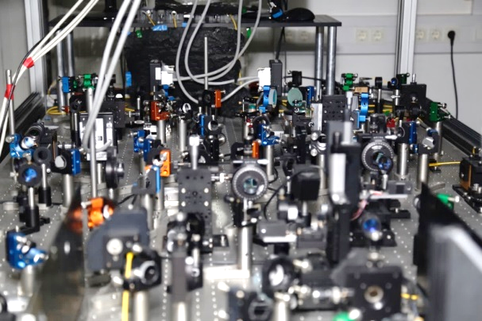
Conclusion
Mario Krenn
AI-based Experimental Design:
In many domains in physics (quantum optics, gravitational wave physics, microscopes/telescopes soon), we have now algorithms for
finding solutions to open questions.
The solutions are presented such that
we can learn and understand new concepts.

Slide 35
Conclusion
Mario Krenn
AI-based Experimental Design:
In many domains in physics (quantum optics, gravitational wave physics, microscopes/telescopes soon), we have now algorithms for
finding solutions to open questions.
The solutions are presented such that
we can learn and understand new concepts.
Automated Idea Generation:
Towards personalized, new, high-impact, interesting research idea generation

Slide 36
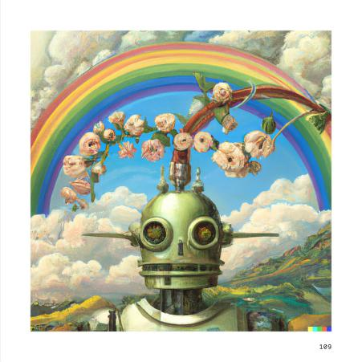
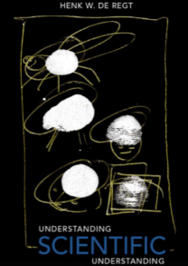
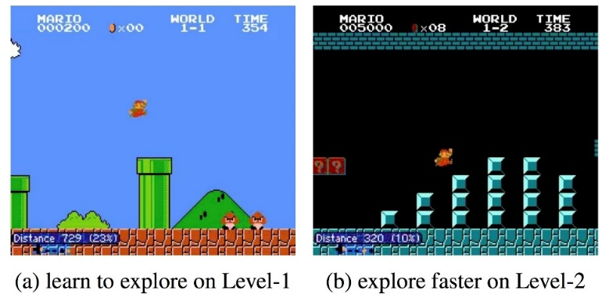
Conclusion
Mario Krenn
AI-based Experimental Design:
In many domains in physics (quantum optics, gravitational wave physics, microscopes/telescopes soon), we have now algorithms for
finding solutions to open questions.
The solutions are presented such that
we can learn and understand new concepts.
Automated Idea Generation:
Towards personalized, new, high-impact, interesting research idea generation
Artificial Scientists
Creativity?
Understanding?
Curiosity?
MK et al., On scientific understanding with artificial intelligence, Nat.Rev.Phys (2022)

